Slide 1
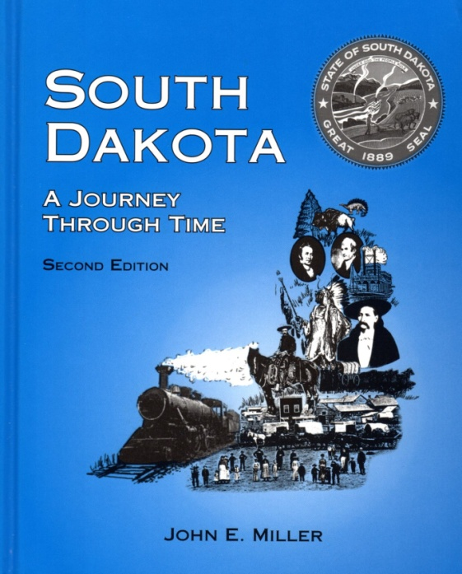
Chapter 6 Vocabulary
Gold in the Black Hills
South Dakota:
A Journey Through Time
by John E. Miller

Slide 2
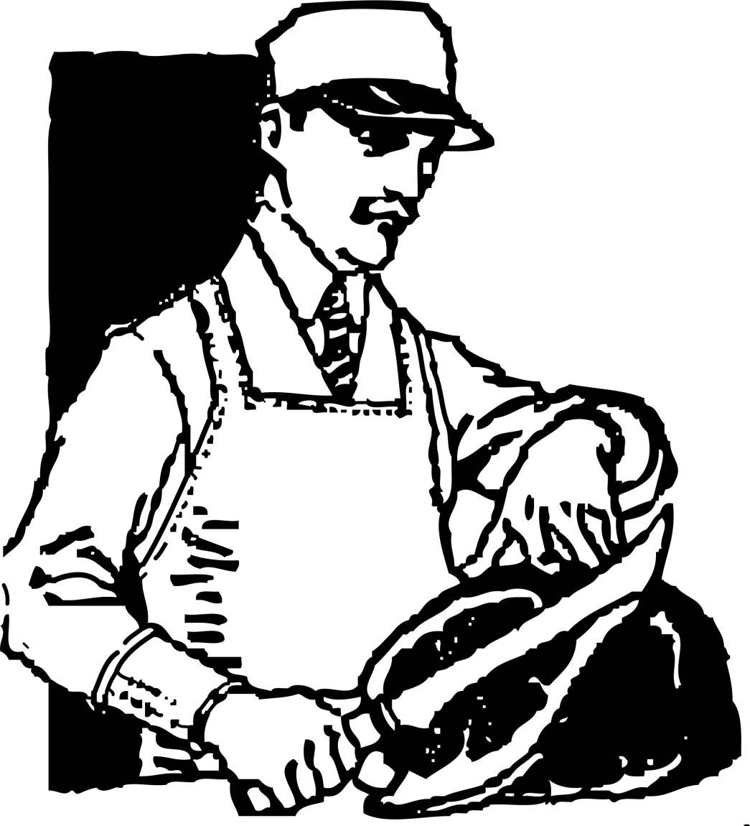
butchered
slaughtered or dressed animals for market

Slide 3
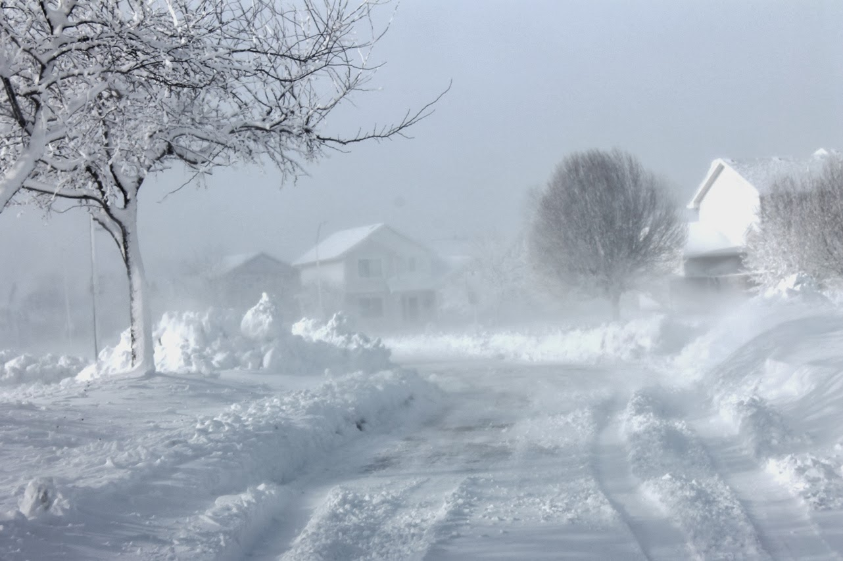
blizzard
windstorm with intense cold and driving snow

Slide 4

calamity
disaster

Slide 5

haberdasheries
men's clothing stores

Slide 6
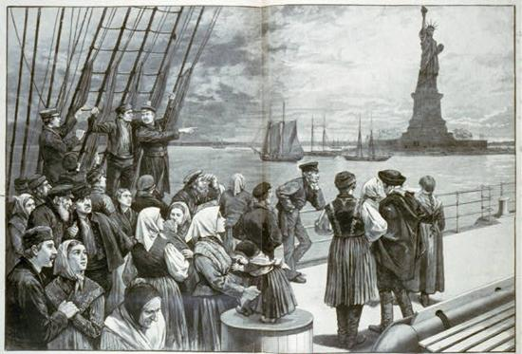
immigrants
people who leave a country to settle in another

Slide 7

marshal
a federal police officer

Slide 8

nationalities
belonging to particular nations

Slide 9
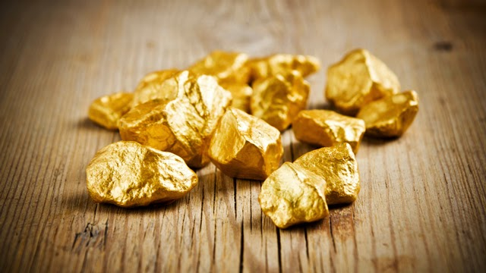
nuggets
small lumps

Slide 10
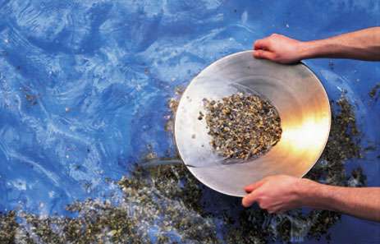
panning
washing in a pan for precious metals

Slide 11
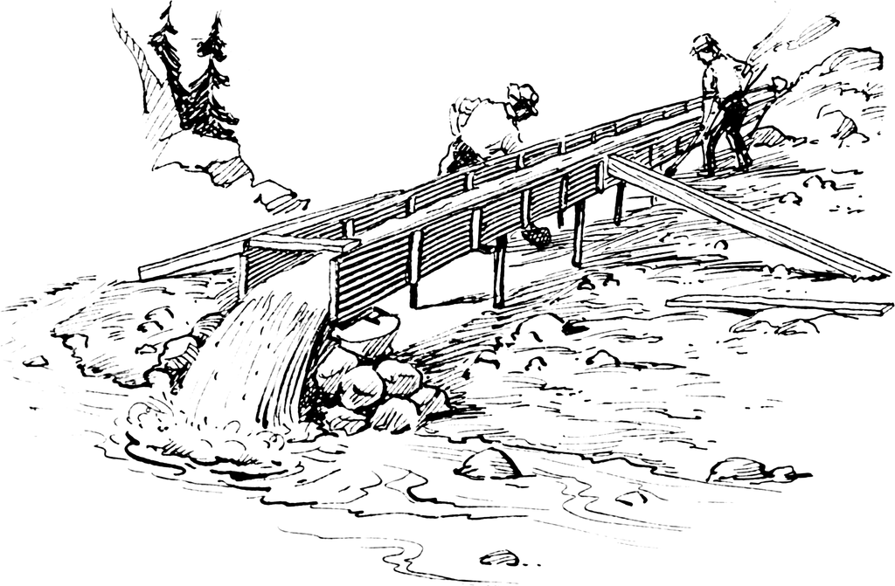
sluice
a long box for separating gold ore

Slide 12

treaty
a formal agreement

Slide 13
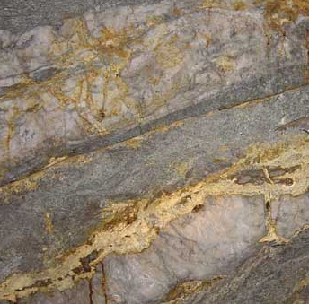
veins
lengthy occurrences of ore

Slide 14
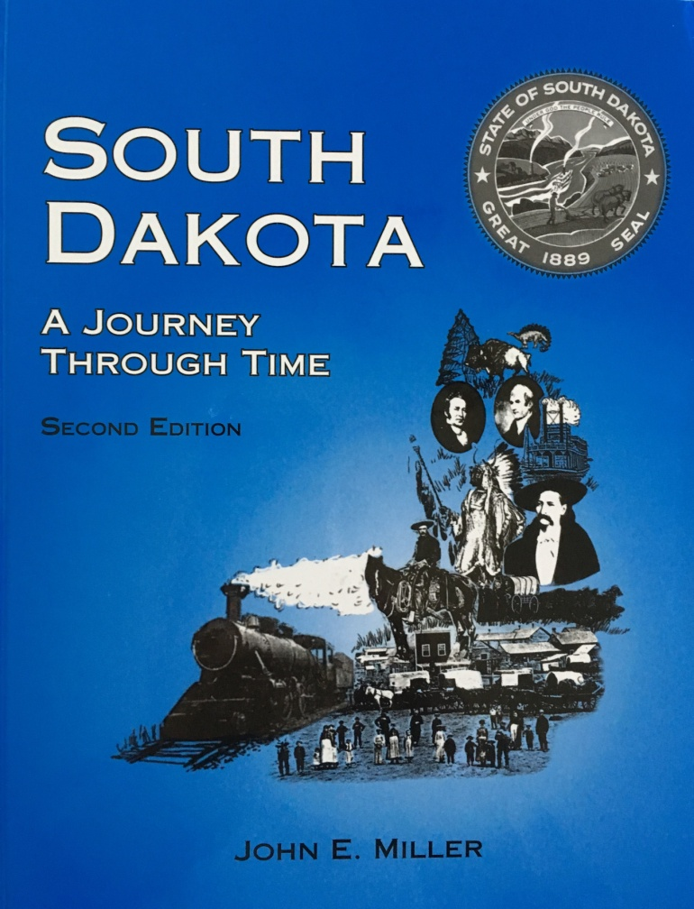
Prairie View Press, LLP
Brookings, SD
Presentation created by Susan Turnipseed
Images from Microsoft Power Point

